Slide 1
Computer Networks
You will learn
Network Loops
How STP works
Basic computer and router configuration

Slide 2
Spanning Tree Protocol
Switching loops problems
SW-1
ROOT
Broadcast storm
FW
FW
Un-stable mac address tables
RP
RP
Duplicate frames
How STP works
SW-2
DP
SW-3
Elect a root bridge
Set a root interfaces to forwarding state
Each non-root switch selects its root port
one port in non-root ports switch choose a designated port
Other ports in non-root ports switch will be in blocking state

Slide 3
Spanning Tree Protocol
Root bridge election
The election processes based on the BID (Bridge ID)
BID : is the stp priority + the mac address ( the lowest BID is the root Bridge)
Type of ports
Root Port : The best port to reach root to reach the Root Bridge
Designated port: Port with the best route to the root bridge on a link
Non- Designated port: All other ports that are in the blocking state
Status of ports
Disabled : port that is shutdown
Blocking : port that is blocking traffic
Each switch should have
Root cost : cost to the root switch
My BID: stp priority+ MAC
ROOT BID : stp Priority + ROOT+MAC
Listening : Not forwarding and not learning mac address
Learning : Not forwarding and learning mac address
Forwarding Sending and receiving traffic like normal

Slide 4
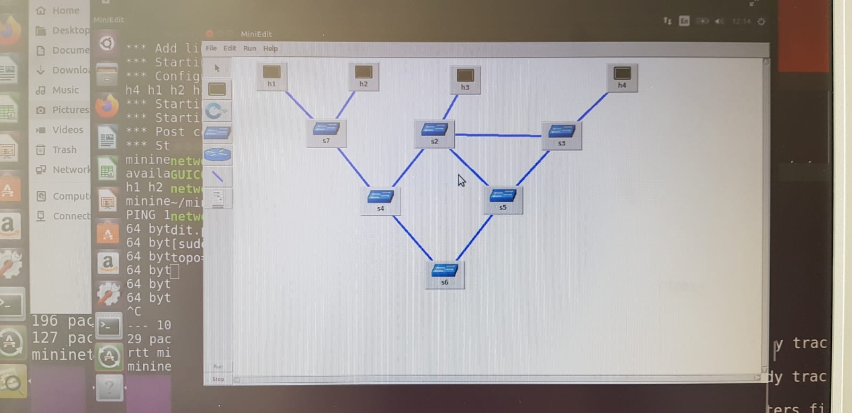
LAB- Loop in Switch (No-STP)
# start it
sudo python sw-topo.py
# check the switches:
sh brctl show
# STP turned off
# h1 and h2 neighbours
h1 ping h2
# really few packets arrive
# h1 and h4 are far from each other
h1 ping h4
# Nothing comes back
# check the network with Tcpdump
s2 tcpdump -n -i any
# conclusion if there is a circle in the graph nothing really works
# exit

Slide 5
LAB- Loop in Switch (STP)
# Start the simulation again
sudo python sw-topo.py –stp
# check the switch status:
sh brctl show
# STP information for s2 switchh:
sh brctl showstp s2
# Does it work now?
h1 ping h2
h1 ping h4
# Everything is fine
# Check the traffic with tcpdump
s2 tcpdump -n -i any or use wireshark
# We can see STP messages
Question ?
Which one is the root bridge ? Why ?
The command
Wireshark –D
will list all the ports that you can listen or monitor

Slide 6
LAB - L3 Routing Configure a host as a router
In this example there are 3 hosts configured: h1 – h2 – h3, and h2 is going to act as a router
# Start it
python test_router.py
# Open up terminals for the hosts
xterm h1 h2 h3
# H2 doesn't have ip for eth1, assign one
ifconfig h2-eth0 10.0.10.1 netmask 255.255.255.0
ifconfig h2-eth1 10.0.20.1 netmask 255.255.255.0
# Allow ipv4_forward
echo 1 > /proc/sys/net/ipv4/ip_forward
# Set up the ip for h1
Ifconfig h1-eth0 0
Ip address ad 10.0.10.2/24 dev h1-eth0
# Set up the ip for h3
Ifconfig h3-eth0 0
Ip address ad 10.0.20.2/24 dev h3-eth0
#Set up the route for h1
Ip route add default via 10.0.10.1 dev h1-eth0
#Set up the route for h3
Ip route add default via 10.0.20.1 dev h3-eth0
This is a process to assign ip address to any interface (linux)
This is how to allow ip forward (linux)
This is a process to assign ip address to any interface (linux)
This is how to add a default rout to the routing table (linux)

